Slide 1

Sustainable Coffee Shop Business Plan
Market Opportunity, Strategy, Financials, and Risk Assessment for a Premium Eco-Friendly Coffee Experience

Slide 2

Table of Contents
Market Opportunity Analysis
Key Success Factors
Financial Projections
Implementation Timeline
Risk Assessment
03
04
05
06
07

Slide 3
Market Opportunity Analysis
VS
Current Market
Our Opportunity
Traditional coffee shops dominate with 85% market share.
Limited sustainable options available.
High prices for organic coffee.
Growing demand for sustainable products (23% annual growth).
Underserved market segment.
Competitive pricing strategy with premium positioning.
3
/
Sustainable Coffee Shop Business Plan

Slide 4
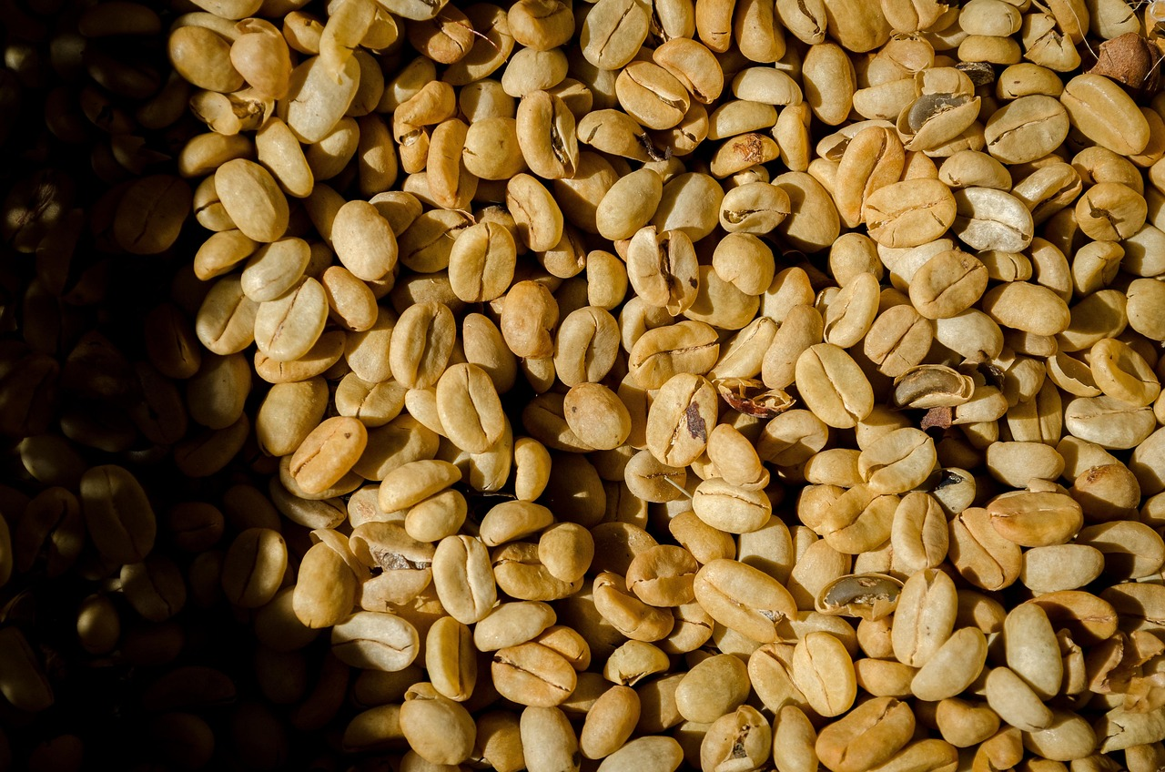
Key Success Factors
01
02
Sustainable Sourcing
Location Strategy
Partner with certified organic coffee farms, implement fair trade practices.
Ensure traceability from bean to cup.
Target high-traffic areas near offices and universities, focus on walkable neighborhoods.
Consider co-working space partnerships.
03
04
Brand Positioning
Technology Integration
Premium sustainable coffee experience, community-focused atmosphere.
Transparent sourcing story.
Mobile ordering app, loyalty program, digital menu boards.
Contactless payment options.
4
/
Sustainable Coffee Shop Business Plan

Slide 5
Financial Projections
First-Year Revenue Projection
Expected Profit Margin
Break-Even Timeline
$450,000
35%
18 months
First-year revenue projection based on market research and competitor analysis.
Expected profit margin through efficient operations and premium pricing strategy.
Break-even timeline with conservative growth assumptions and proper capital allocation.
5
/
Sustainable Coffee Shop Business Plan

Slide 6
Implementation Timeline
Month 1-2: Market Research and Funding
Conduct market research, scout locations, and secure initial funding and partnerships.
Month 3-4: Lease and Permits
Negotiate lease agreements, design the space, and obtain necessary permits and licenses.
Month 5-6: Renovation and Staffing
Complete renovations, install equipment, and hire and train staff.
1
2
3
4
5
Month 7: Soft Launch
Initiate a soft launch with a limited menu, gather customer feedback, and refine operations.
Month 8+: Full Launch and Expansion
Execute a full launch with a complete menu, marketing campaigns, and plan for future expansion.
6
/
Sustainable Coffee Shop Business Plan

Slide 7
Risk Assessment
S
W
Strengths
Weaknesses
Strong market demand for sustainable options, experienced team, unique value proposition.
These factors position the business to effectively meet consumer needs and stand out in the market.
Limited initial capital, new brand recognition, dependency on coffee suppliers.
These challenges could hinder growth and operational stability in the early stages.
O
T
Opportunities
Threats
Growing sustainability trend, potential for franchise expansion, online coffee subscription service.
These opportunities provide avenues for scaling and diversifying the business.
Competition from established chains, fluctuating coffee bean prices, changing consumer preferences.
These risks could impact profitability and require strategic mitigation.
7
/
Sustainable Coffee Shop Business Plan

